Slide 1


E-PROJECT
NEXUS
SERVICE MARKETING SYSTEM

Slide 2

TABLE OF CONTENT
2
HOME
6
SERVICES
3
NAV/FOOTER
7
CONNECTION
4
PLANS
8
TEAM
5
EQUIPMENTS
9
CONTACT

Slide 3
INTRODUCTION
Nexus Communication System is an Organization system that provides two services like the Tele-communications and Internet Services. It is one of the major vendors at the local place. It has now extended its service all over the territory due to the increase in demand for the internet service.
They actually provide two types of connections, one being the Dial – Up connection and the Broadband connection. Due to the increase in demand for connection and as to increase the comfort level, they have opened the retail shops at each place so that the customer can enquire regarding the connection or place an order for the connection by directly visiting to the retail shops at their place in that city, instead of applying at the office at their city.

Slide 4
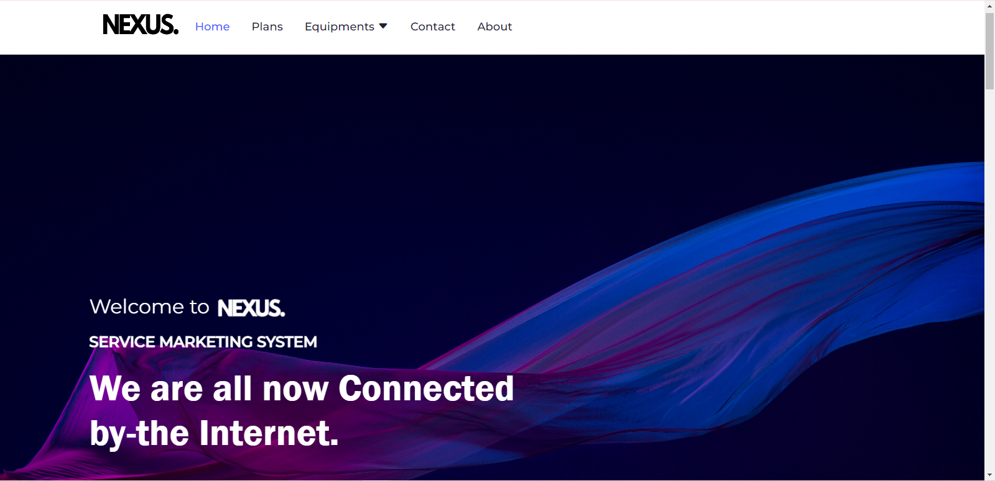
HOME

Slide 5
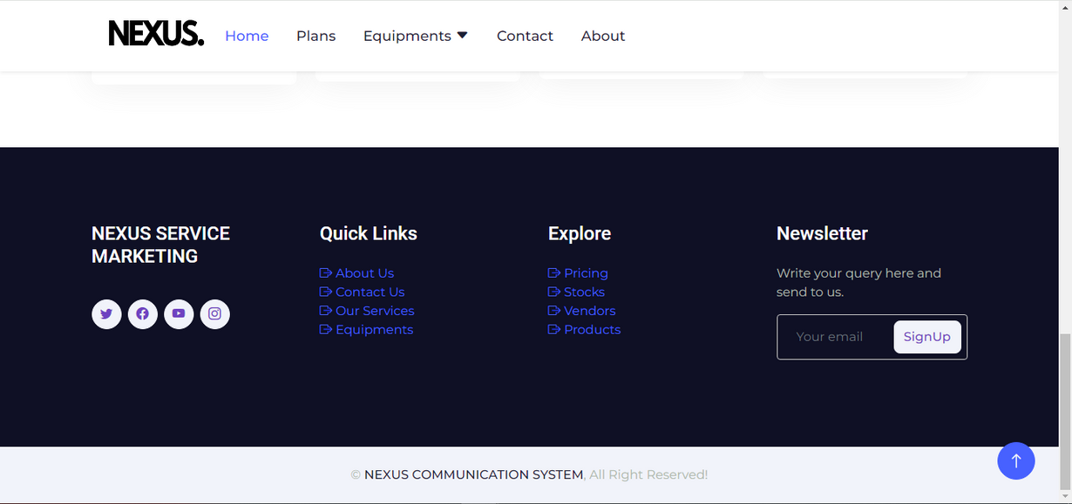
NAVBAR
FOOTER

Slide 6

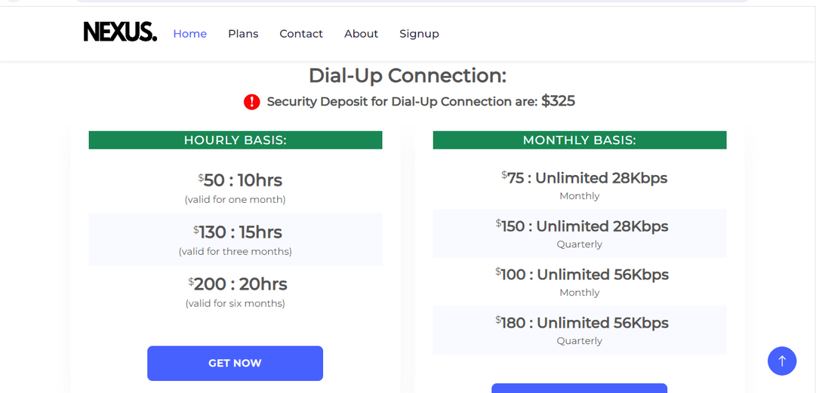
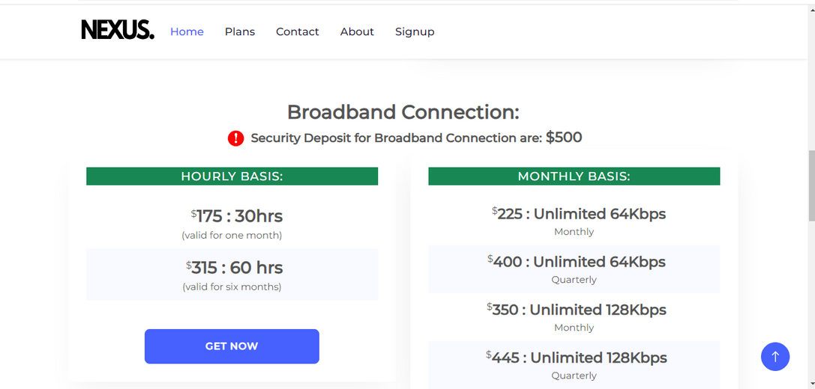
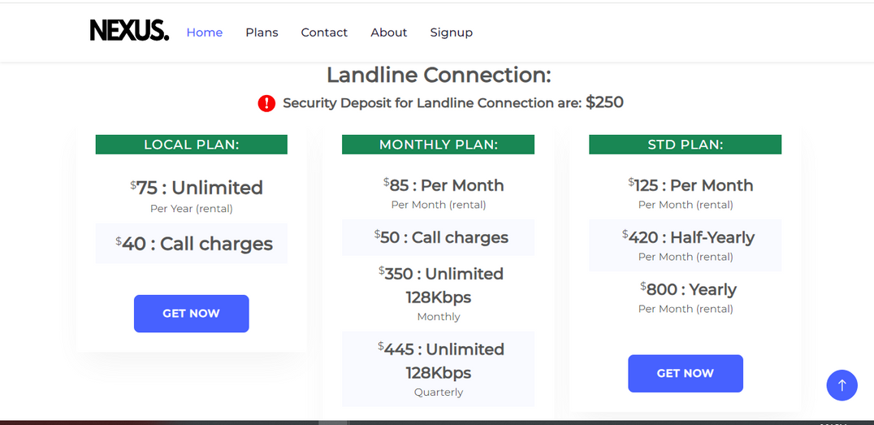
PLANS

Slide 7
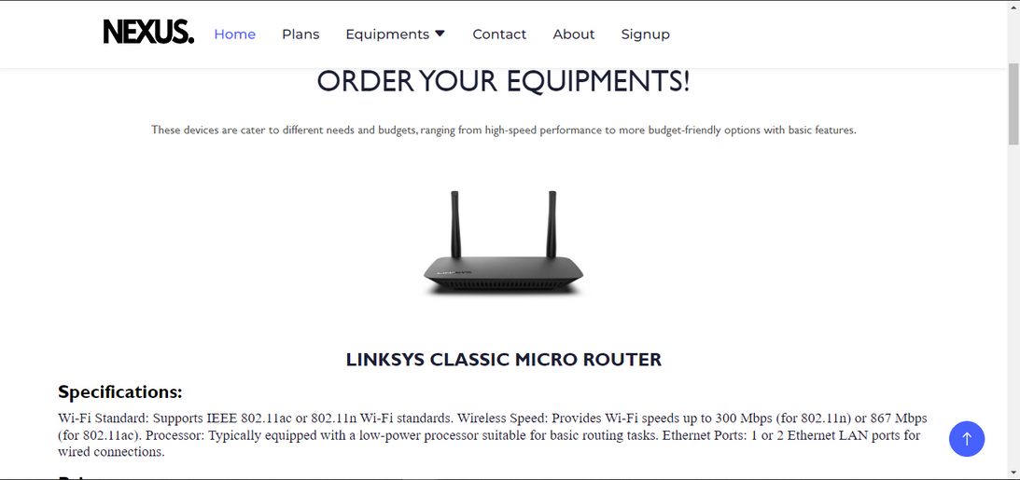
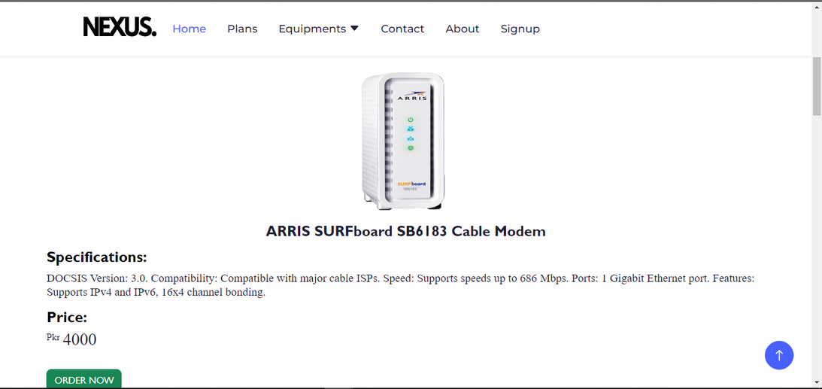
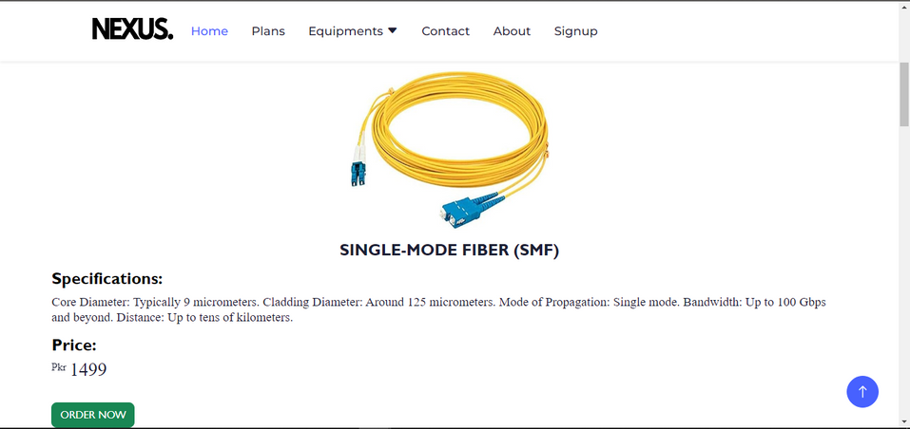
EQUIPMENTS

Slide 8
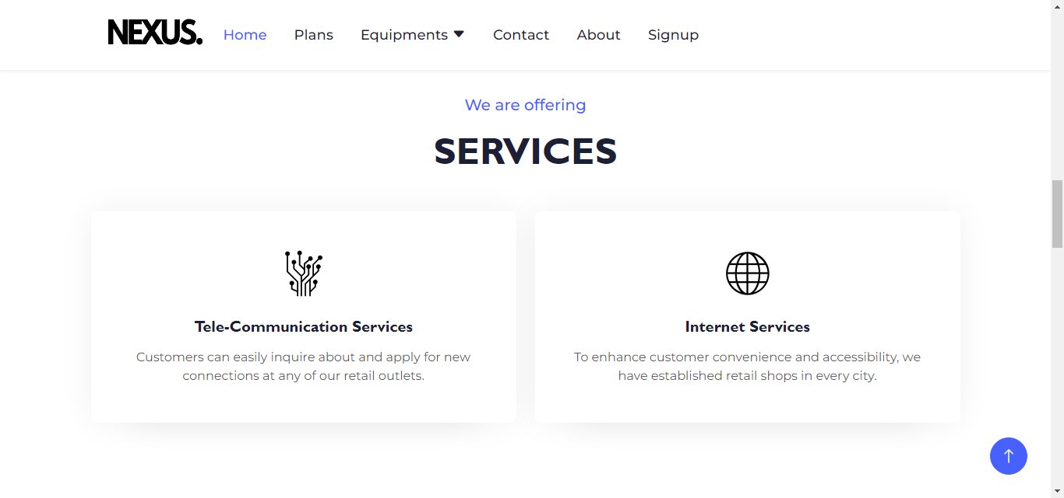
SERVICES

Slide 9
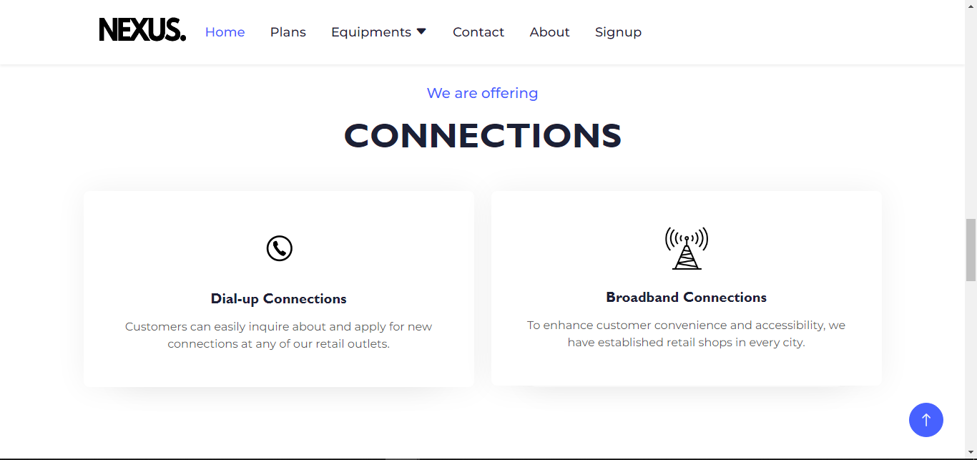
CONNECTION

Slide 10
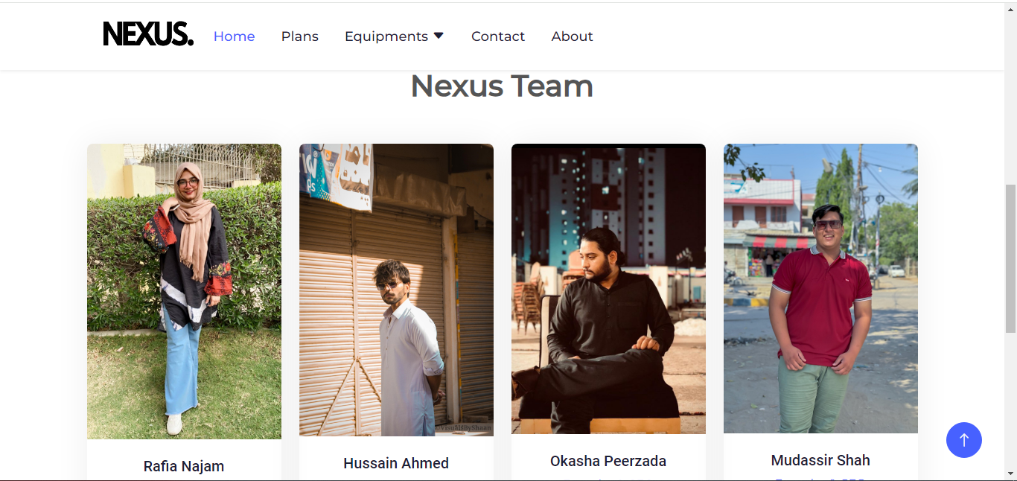
TEAM

Slide 11
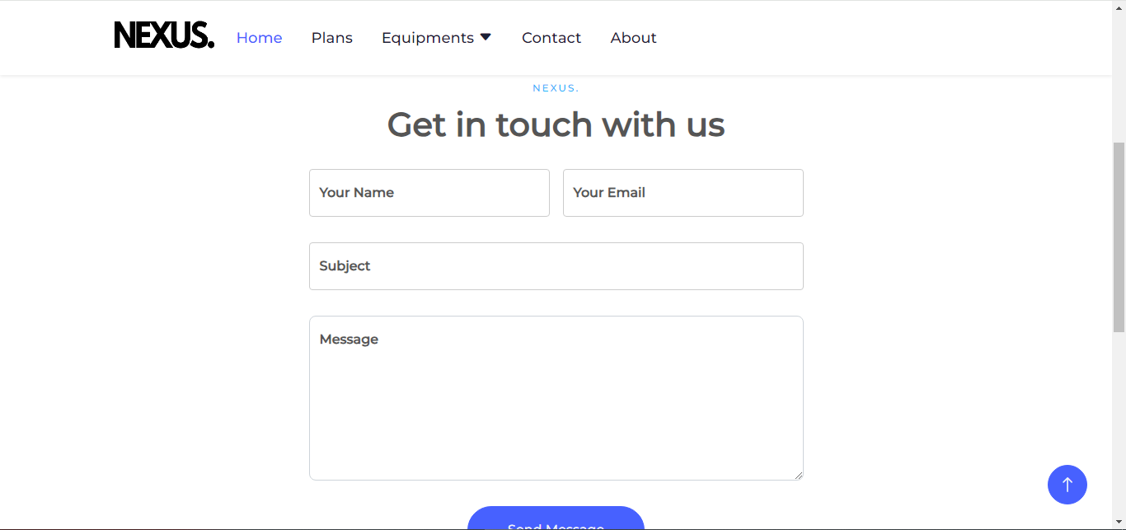
CONTACT

Slide 12


